Slide 1
Chapter 17
Additional Aspects of Aqueous Equilibria

Slide 2
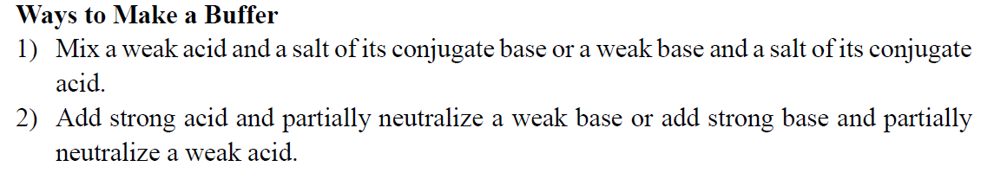
1. Which one of the following pairs cannot be mixed together to form a buffer solution? ________
A) C₅H₅N, C₅H₅NHCl
B) HC₂H₃O₂, NaOH (C₂H₃O₂– = acetate)
C) KOH, HI
D) NH₂CH₃, HCl
E) NaClO, HNO₃
C

Slide 3
2. The addition of sodium hydroxide and ________ to water produces a buffer solution.
A) HCl
B) NaC₂H₃O₂
C) NaF
D) NH₃
E) none of the above
E

Slide 4
3. Of the following solutions, which has the greatest buffering capacity? ________
A) 1.15 M HF and 0.624 M NaF
B) 0.574 M HF and 0.312 M NaF
C) 0.287 M HF and 0.156 M NaF
D) 0.189 M HF and 0.103 M NaF
E) They are all buffer solutions and would all have the same capacity.
A

Slide 5
4. Which of the following could be added to a solution of sodium acetate to produce a buffer? ________
A) acetic acid only
B) acetic acid or hydrochloric acid
C) hydrochloric acid only
D) potassium acetate only
E) sodium chloride or potassium acetate
B

Slide 6
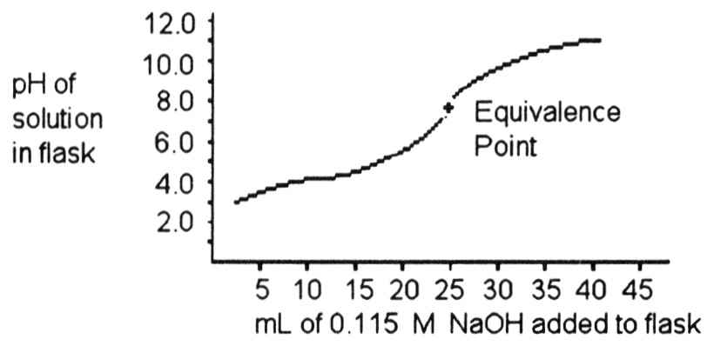
5. A 25.0 mL sample of a solution of an unknown compound is titrated with a 0.115 M NaOH solution. The titration curve above was obtained. The unknown compound is ________.
A) a strong acid
B) a strong base
C) a weak acid
D) a weak base
E) neither an acid nor a base
C

Slide 7
6. The solubility of lead (II) chloride (PbCl₂) is 1.6 × 10⁻² M. What is the Ksp of PbCl₂? ________
A) 5.0 × 10⁻⁴
B) 4.1 × 10⁻⁶
C) 3.1 × 10⁻⁷
D) 1.6 × 10⁻⁵
E) 1.6 × 10⁻²
D

Slide 8
7. What is the solubility (in M) of PbCl₂ in a 0.15 M solution of HCl? The Ksp of PbCl₂ is 1.6 × 10⁻⁵. ________
A) 2.0 × 10⁻³
B) 1.1 × 10⁻⁴
C) 1.8 × 10⁻⁴
D) 7.1 × 10⁻⁴
E) 1.6 × 10⁻⁵
D

Slide 9
8. Consider a solution containing 0.100 M fluoride ions and 0.126 M hydrogen fluoride. The concentration of hydrogen fluoride after addition of 9.00 mL of 0.0100 M HCl to 25.0 mL of this solution is ________ M.
A) 0.0709
B) 0.0900
C) 0.130
D) 0.122
E) 0.00976
A

Slide 10
10. The pH of a solution prepared by mixing 55.0 mL of 0.183 M KOH and 10.0 mL of 0.145 M HC₂H₃O₂ is ________.
A) 9.97
B) 7.74
C) 0.878
D) 13.122
E) none of the above
D

